Slide 1
Information Retrieval
Topic- Evaluation in information
Retrieval (ranked evaluation)
Lecture-28
Prepared By
Dr. Rasmita Rautray & Dr. Rasmita Dash
Associate Professor
Dept. of CSE

Slide 2
Evaluation in information
Retrieval

Slide 3
Content
Ranked retrieval
ROC curve

Slide 4
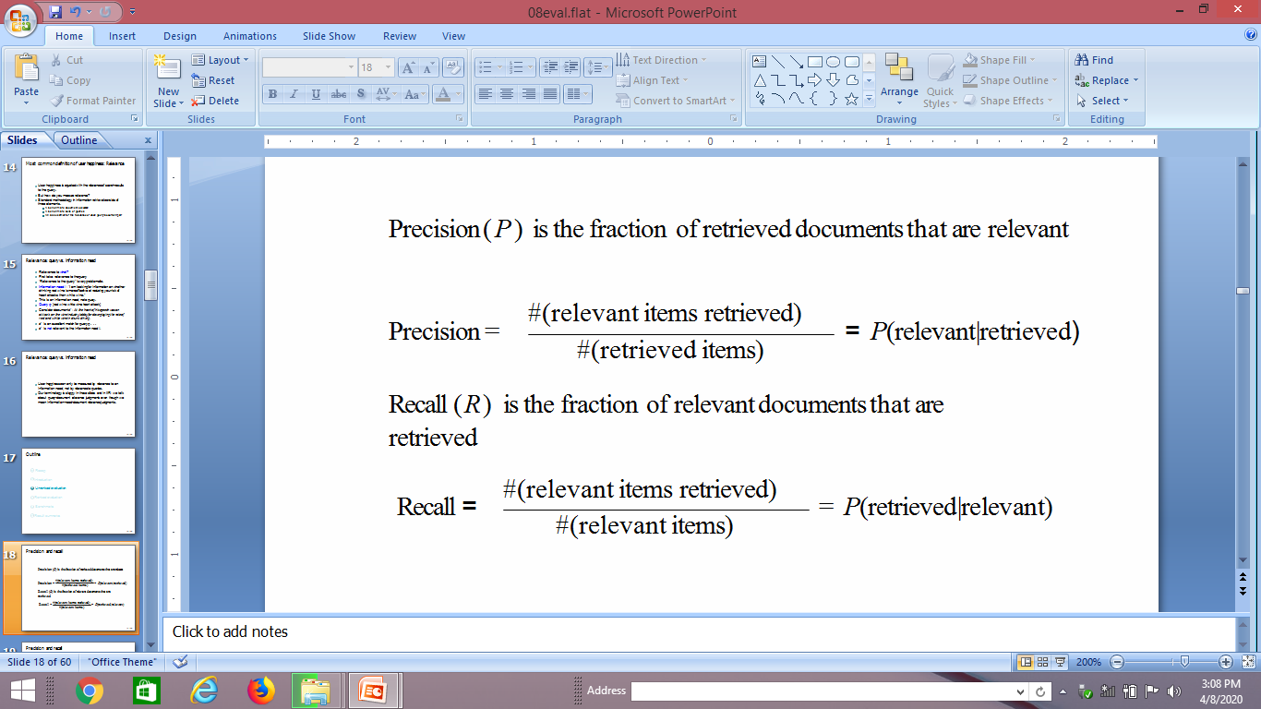
Precision and recall

Slide 5
Precision and recall
 | Relevant | Nonrelevant
Retrieved | true positives (TP) | false positives (FP)
Not retrieved | false negatives (FN) | true negatives (TN)
P = TP/(TP + FP)
R = TP/(TP + FN)

Slide 6
Precision/recall tradeoff
Recall can be increased by returning more docs.
Recall is a non-decreasing function of the number of docs retrieved.
A system that returns all docs has 100% recall!
The converse is also true (usually): It’s easy to get high precision for very low recall.
Suppose the document with the largest score is relevant. How can we maximize precision?

Slide 7
Example for precision, recall, F1
 | relevant | not relevant
retrieved | 20 | 40 | 60
not retrieved | 60 | 1,000,000 | 1,000,060
 | 80 | 1,000,040 | 1,000,120
P = 20/(20 + 40) = 1/3
R = 20/(20 + 60) = 1/4
F₁ = 2/7

Slide 8
Accuracy
Why do we use complex measures like precision, recall, and F ?
Why not something simple like accuracy?
Accuracy is the fraction of decisions (relevant/nonrelevant) that are correct.
In terms of the contingency table above, accuracy = (TP + TN)/(TP + FP + FN + TN).

Slide 9
Why accuracy is a useless measure in IR
Simple trick to maximize accuracy in IR: always say no and return nothing
We then get 99.99% accuracy on most queries.
Searchers on the web (and in IR in general) want to find something and have a certain tolerance for junk.
It’s better to return some bad hits as long as we return something.
→ We use precision, recall, and F for evaluation, not accuracy.

Slide 10
F: Why harmonic mean?
Why don’t we use a different mean of P and R as a measure?
e.g., the arithmetic mean
Desideratum: Punish really bad performance on either precision or recall.
Taking the minimum achieves this.
But minimum is not smooth and hard to weight.
F (harmonic mean) is a kind of smooth minimum.

Slide 11
Ranked evaluation

Slide 12
Precision-recall curve
Precision/recall/F are measures for unranked sets.
We can easily turn set measures into measures of ranked lists.
Just compute the set measure for each “prefix”: the top 1, top 2, top 3, top 4 etc results
Doing this for precision and recall gives you a precision-recall curve.

Slide 13
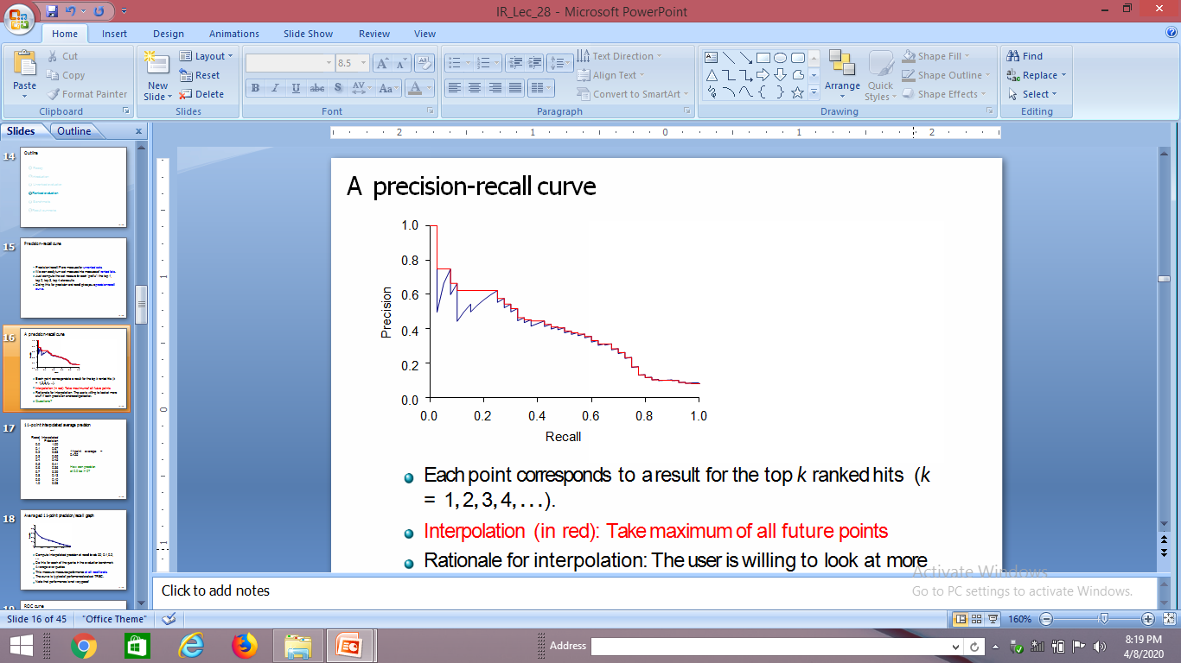
A precision-recall curve
Each point corresponds to a result for the top k ranked hits (k = 1, 2, 3, 4, . . .).
Interpolation (in red): Take maximum of all future points
Rationale for interpolation: The user is willing to look at more stuff if both precision and recall get better.

Slide 14
11-point interpolated average precision
Recall | Interpolated Precision
0.0 | 1.00
0.1 | 0.67
0.2 | 0.63
0.3 | 0.55
0.4 | 0.45
0.5 | 0.41
0.6 | 0.36
0.7 | 0.29
0.8 | 0.13
0.9 | 0.10
1.0 | 0.08
11-point average: ≈0.425
How can precision at 0.0 be > 0?

Slide 15
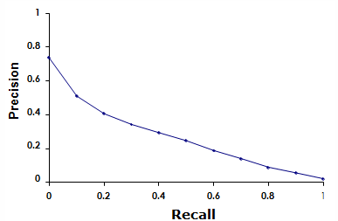
Averaged 11-point precision/recall graph
Compute interpolated precision at recall levels 0.0, 0.1, 0.2,
. . .
Do this for each of the queries in the evaluation benchmark Average over queries
This measure measures performance at all recall levels.
The curve is typical of performance levels at TREC.
Note that performance is not very good!

Slide 16
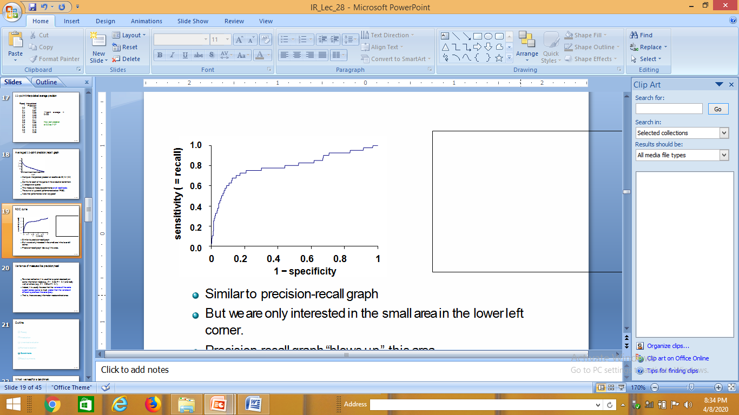
ROC curve
Similar to precision-recall graph
But we are only interested in the small area in the lower left corner.
Precision-recall graph “blows up” this area.

Slide 17
Variance of measures like precision/recall
For a test collection, it is usual that a system does badly on some information needs (e.g., P = 0.2 at R = 0.1) and really well on others (e.g., P = 0.95 at R = 0.1).
Indeed, it is usually the case that the variance of the same system across queries is much greater than the variance of different systems on the same query.
That is, there are easy information needs and hard ones.

Slide 18
Thank You

